Slide 1

News Aggregation System Update Slide
Team 3
Parth Shah, Ankana Asit Samantha, Sreepad

Slide 2
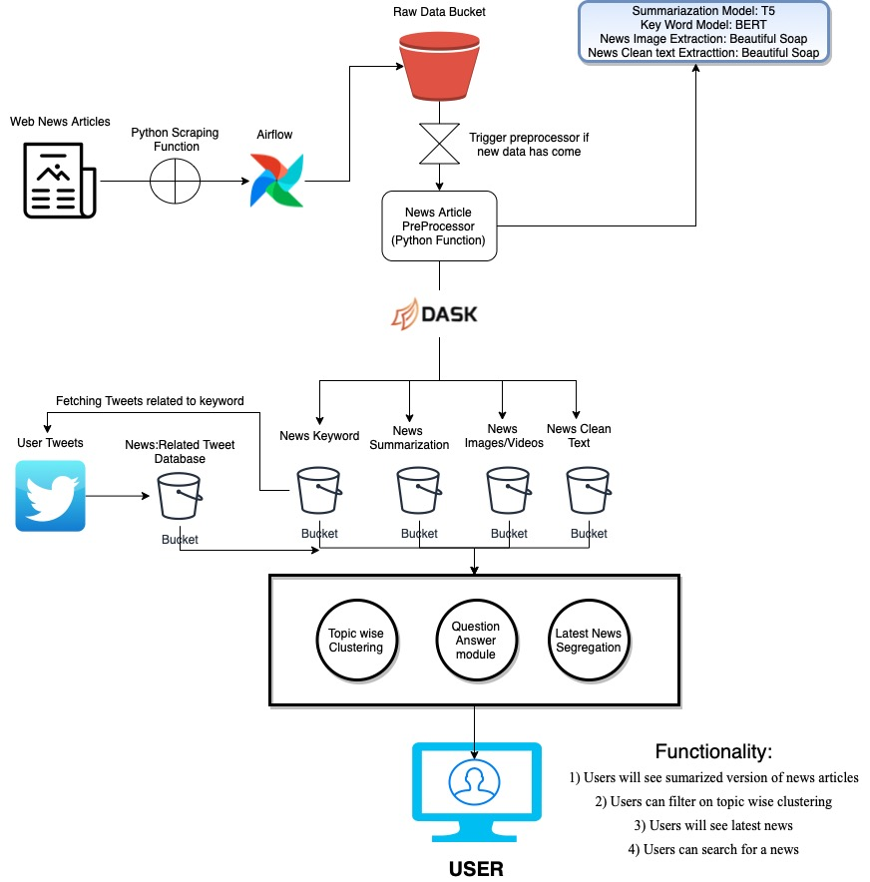
Architecture
Main Modules:
1) Preprocessor Module
2) Tweet Extractor Module
3) Scrapper Module
4) Code Commenting
5) Streamlit basic UI

Slide 3
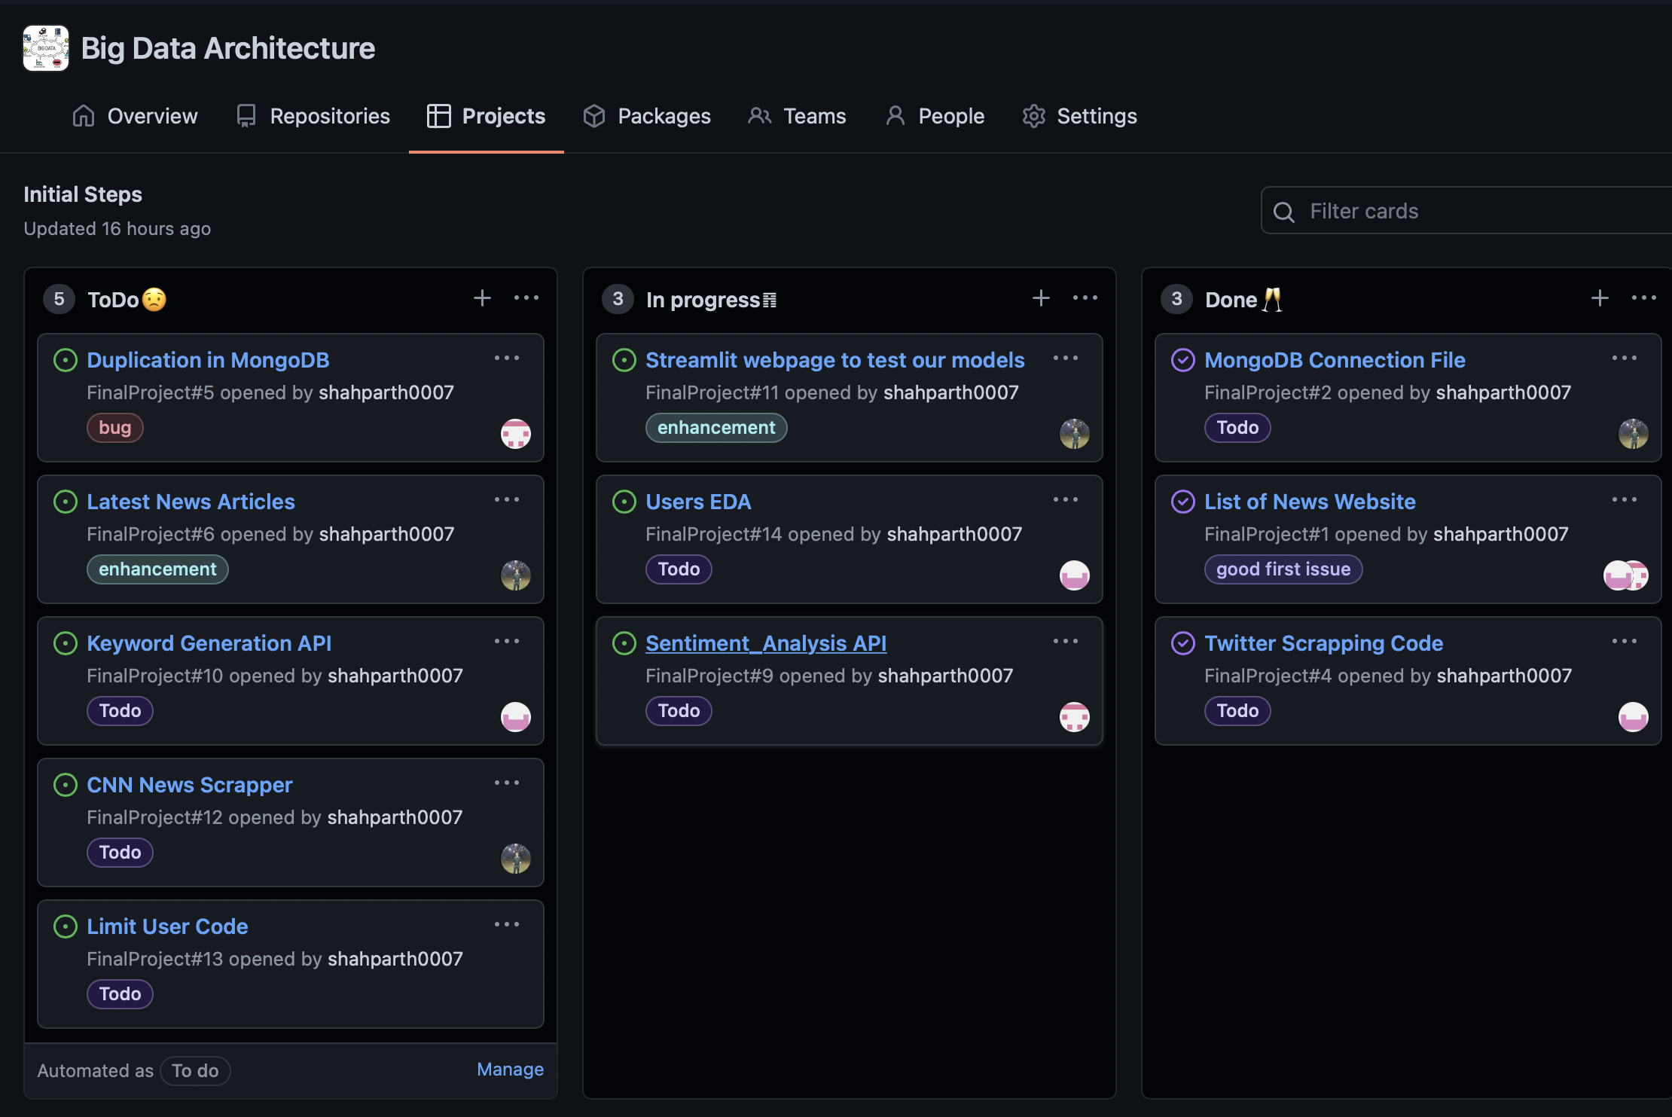
Timeline Project
Scrapper Module
Pre Processor Module
Tweet Extraction Module
Streamlit
Testing
Deployment
Week 1
Week 1
Week 2
Week 2
Week 3

Slide 4
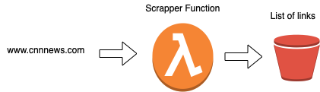
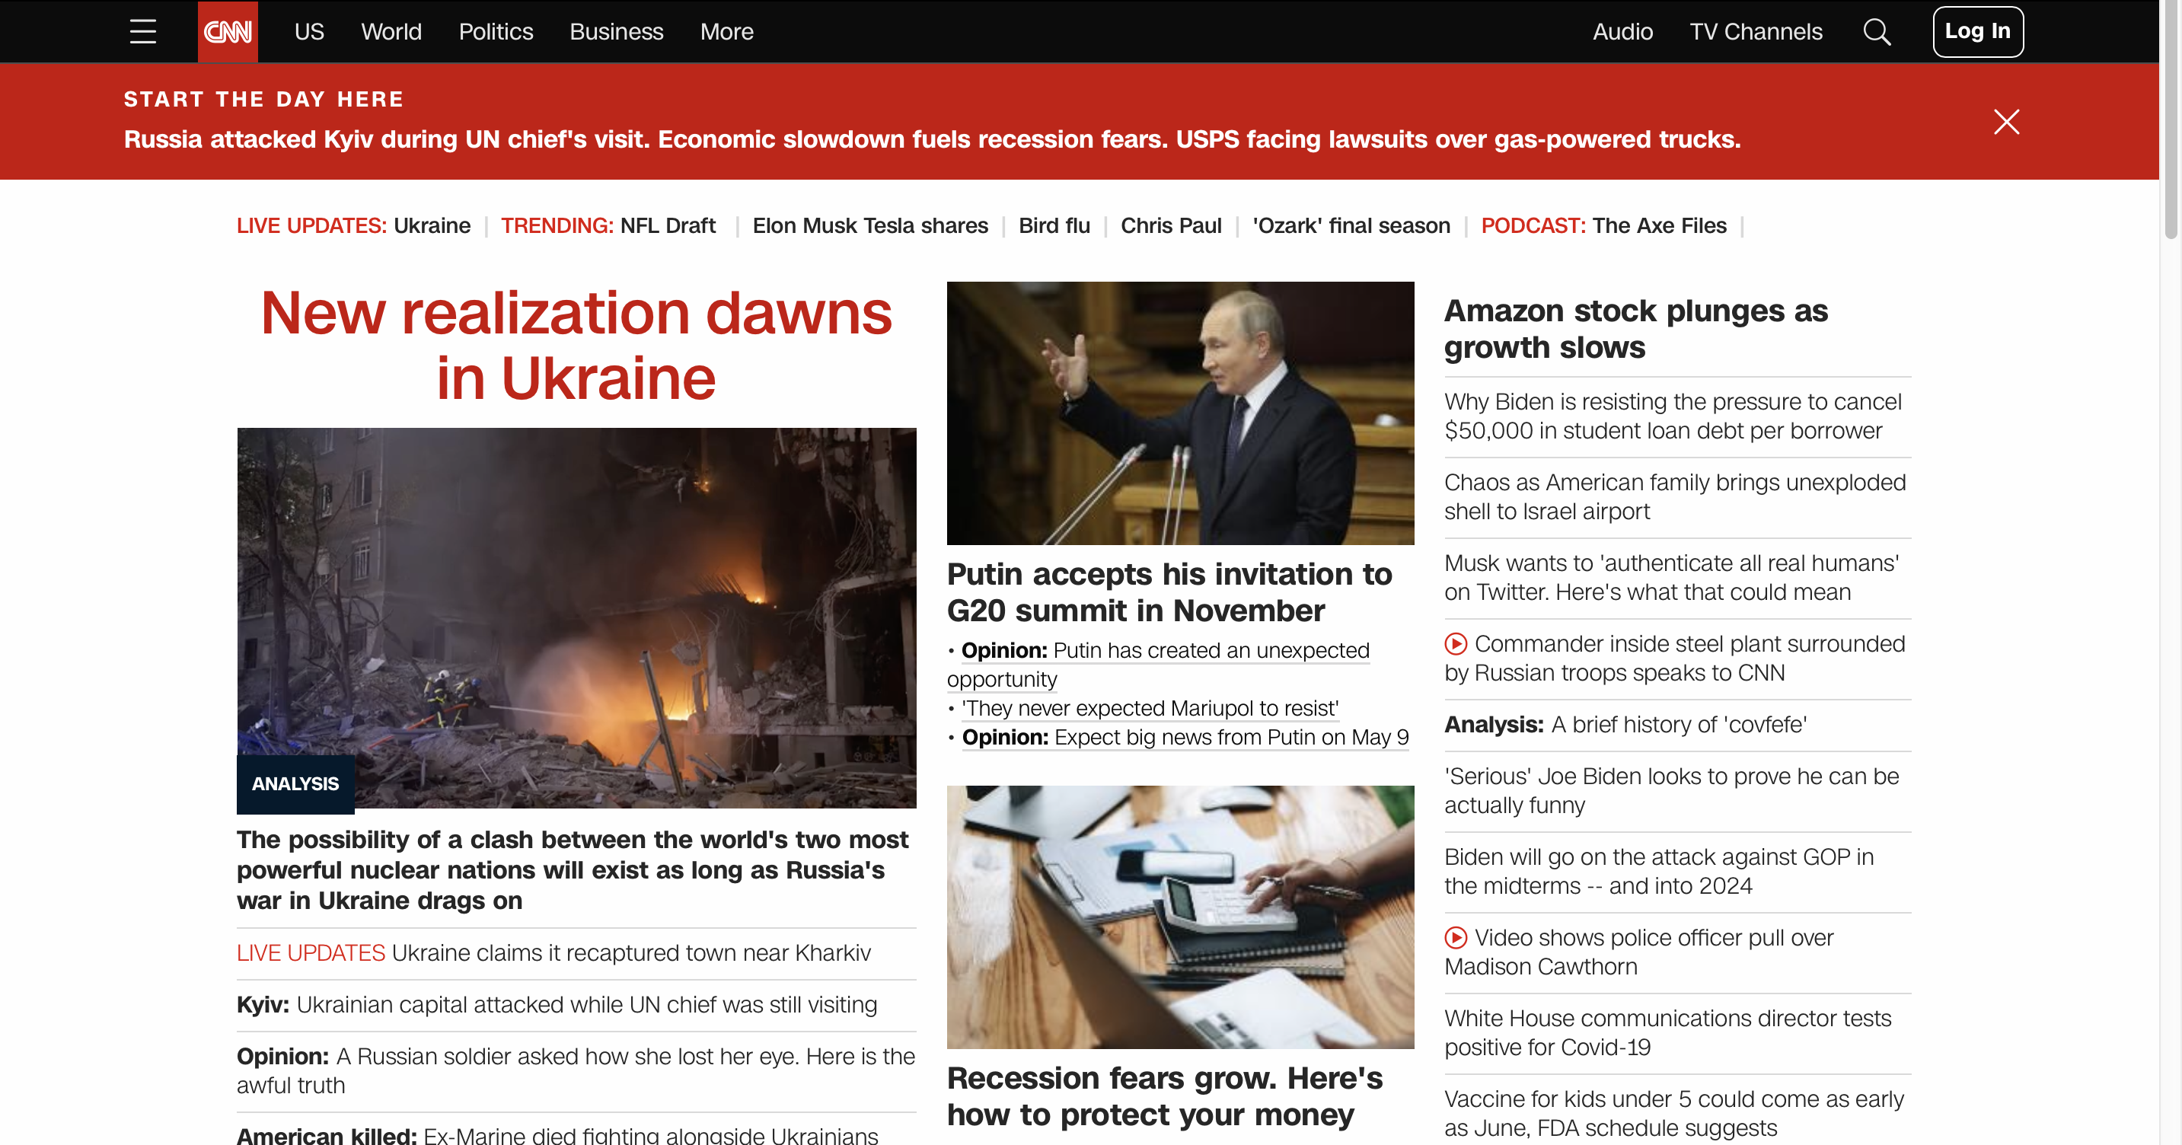
Scrapper Module
Scrapper Module
Week 1
Author Parth Shah shah.parth3@northeastern.edu
Scrapper Module are used to extract links of the news article from the website!
1) Google API’s
2) Times of India Scrapper Function
3) CNN Scrapper Function
4) Live-Mint Scrapper Function

Slide 5
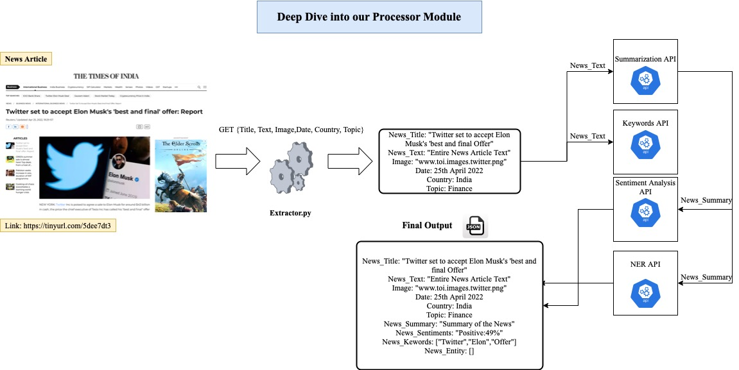
Pre Processor Module
Pre Processor Module
Week 1
Author Parth Shah shah.parth3@northeastern.edu
Sreepad Pairagi
Steps:
Select a news link to extract
2) Pass it to extractor.py
3) Pass it to API’S
Summarization API
Keywords API
Sentiment Anlaysis API
4) Save it in MongoDB

Slide 6
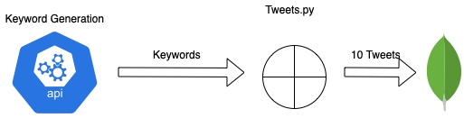
Tweet Extractor Module
Tweet Extraction Module
Week 2
Author Ankana Asit Samanta
Keywords generated by Keywords API are passed to tweets.py which extracts tweets
Based on that keywords and time frame

Slide 7
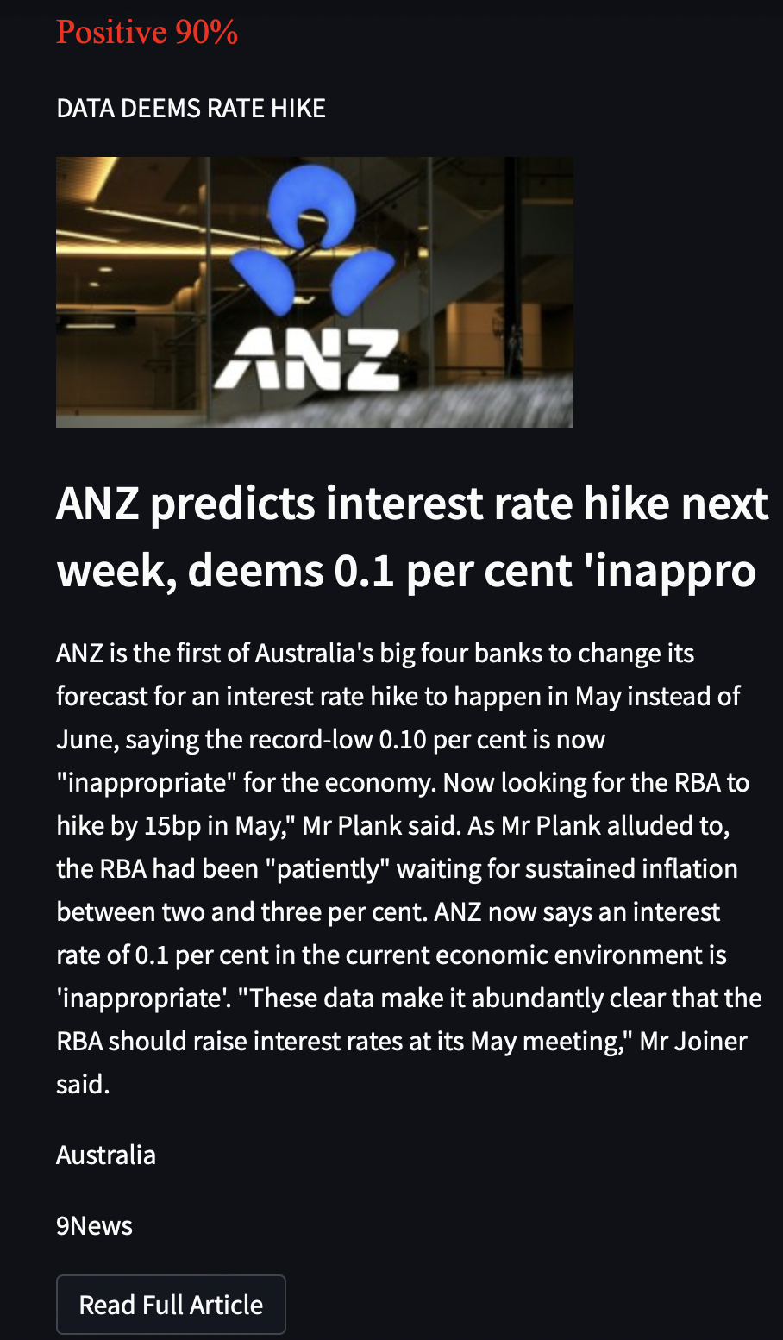
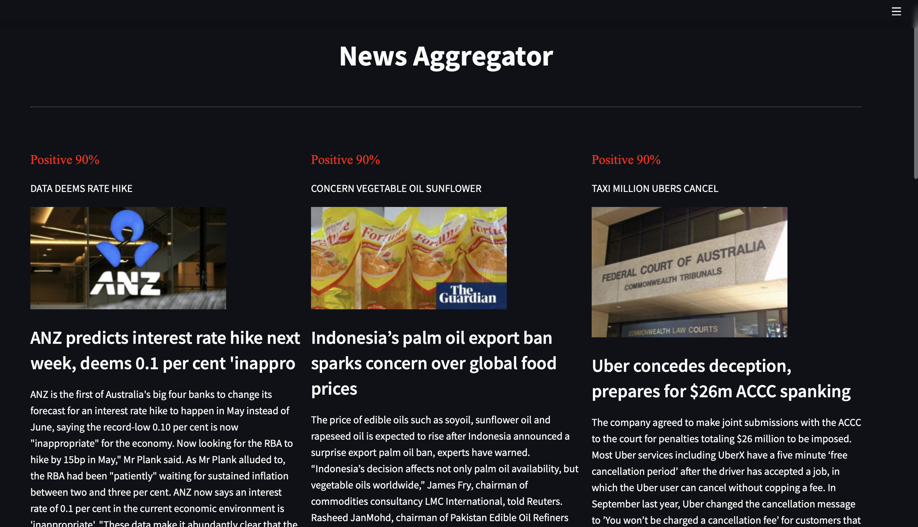
Streamlit
Sentiments
Keywords
Summary
Country
Full Article

Slide 8
Week 3 Tasks
1) Integrate tweets with each news on Streamlit
2) Integrate Question Answering Module on Streamlit
3) Feedback from user
3) User’s Analysis based on what user’s read ( Top keywords of user, top sentiments of users)
4) Email users with news
5) Testing of All API’S
6) Streamlit Deployment and Testing
Atomic Testing/ integration Testin
7) Architectural diagram explaination
--- Every component explaination
---Pros and cons
---why was this choice

Slide 9
Stopping Points:
1) The keywords generated from model are not able to extract very relevant tweets
Suggestions?
1) Can we add anything more to our application which is useful for users

